Slide 1
FULL STACK TRAINING

Slide 2
SELF INTRODUCTION
NAME
WHERE YOU ARE FROM
EDUCATION
BRIEF WORK EXPERIENCE OVERVIEW
SKILLS
WHAT YOU’D LIKE TO DO
WHAT BRINGS YOU HERE

Slide 3
AGENDA
Week 1 – SDLC, Agile Development, useful concepts in core java, project design commencement
Week 2 – JMX, Manual Software Testing, continuation of project development (back end)
Week 3 – JMS, design of the Web APIs for the back end
Week 4 – Angular JS, continuation of project
Week 5 – Angular JS, commencement of UI design for project
Week 6 – Angular JS, UI design continuation
Week 7 – Bootstrap, UI enhancements and finalization
Week 8 – Authentication, Login design for Application and deployment

Slide 4
SDLC (SOFTWARE DEVELOPMENT LIFE CYCLE)
SDLC stands for Software Development Life Cycle. SDLC is a process that consists of a series of planned activities to develop or alter the Software Products. This session will give you an overview of the SDLC basics, SDLC models available and their application in the industry.
Following the SDLC overview, we will conduct a deep dive into one of the most popular SDLC methodologies ‘Agile’ and its implementation using ‘Scrum’

Slide 5
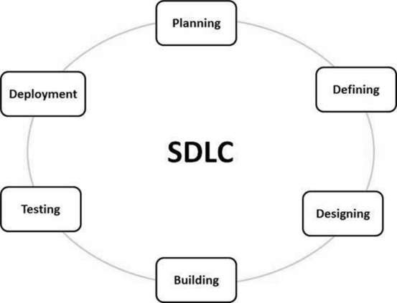
SDLC Stages
Stage 1: Planning and Requirement Analysis
Stage 2: Defining Requirements
Stage 3: Designing the Product Architecture
Stage 4: Building or Developing the Product
Stage 5: Testing the Product
Stage 6: Deployment in the Market and Maintenance

Slide 6
SDLC Models
Waterfall Model
Iterative Model
Spiral Model
V-Model
Big Bang Model
Agile Model
RAD Model
Software Prototyping

Slide 7
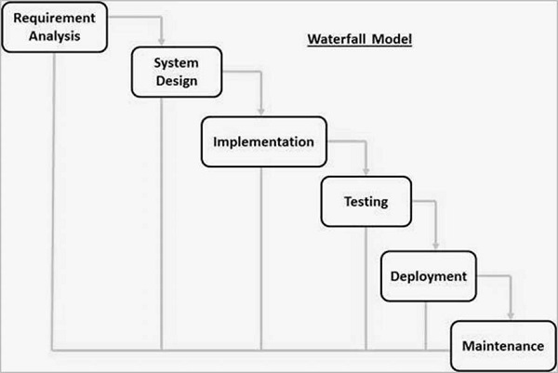
Waterfall Model
Requirement Gathering and analysis -
System Design
Implementation
Integration and Testing
Deployment of system
Maintenance

Slide 8
Where to apply Waterfall model
Requirements are very well documented, clear and fixed.
Product definition is stable.
Technology is understood and is not dynamic.
There are no ambiguous requirements.
Ample resources with required expertise are available to support the product.
The project is short.

Slide 9
Waterfall Model
Pros
Cons
Simple and easy to understand and use
Easy to manage due to the rigidity of the model. Each phase has specific deliverables and a review process.
Phases are processed and completed one at a time.
Works well for smaller projects where requirements are very well understood.
Clearly defined stages.
Well understood milestones.
Easy to arrange tasks.
Process and results are well documented.
No working software is produced until late during the life cycle.
High amounts of risk and uncertainty.
Not a good model for complex and object-oriented projects.
Poor model for long and ongoing projects.
Not suitable for the projects where requirements are at a moderate to high risk of changing. So, risk and uncertainty is high with this process model.
It is difficult to measure progress within stages.
Cannot accommodate changing requirements.
Adjusting scope during the life cycle can end a project.
Integration is done as a "big-bang. at the very end, which doesn't allow identifying any technological or business bottleneck or challenges early.

Slide 10
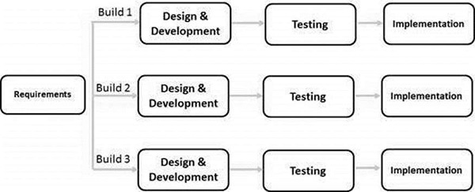
Iterative Model
More than one iteration of the software development cycle may be in progress at the same time
Incremental build approach
As the software evolves through successive cycles, tests must be repeated and extended to verify each version of the software.

Slide 11
Where to apply Iterative model
Requirements of the complete system are clearly defined and understood.
Major requirements must be defined; however, some functionalities or requested enhancements may evolve with time.
There is a time to the market constraint.
A new technology is being used and is being learnt by the development team while working on the project.
Resources with needed skill sets are not available and are planned to be used on contract basis for specific iterations.
There are some high-risk features and goals which may change in the future.

Slide 12
Iterative Model
Pros
Cons
Some working functionality can be developed quickly and early in the life cycle.
Results are obtained early and periodically.
Parallel development can be planned.
Progress can be measured.
Less costly to change the scope/requirements.
Testing and debugging during smaller iteration is easy.
Risks are identified and resolved during iteration; and each iteration is an easily managed milestone.
Easier to manage risk - High risk part is done first.
With every increment, operational product is delivered.
Issues, challenges and risks identified from each increment can be utilized/applied to the next increment.
Risk analysis is better.
It supports changing requirements.
Initial Operating time is less.
Better suited for large and mission-critical projects.
During the life cycle, software is produced early which facilitates customer evaluation and feedback.
More resources may be required.
Although cost of change is lesser, but it is not very suitable for changing requirements.
More management attention is required.
System architecture or design issues may arise because not all requirements are gathered in the beginning of the entire life cycle.
Defining increments may require definition of the complete system.
Not suitable for smaller projects.
Management complexity is more.
End of project may not be known which is a risk.
Highly skilled resources are required for risk analysis.
Projects progress is highly dependent upon the risk analysis phase.

Slide 13
Spiral Model
Identification
This phase starts with gathering the business requirements in the baseline spiral.
Design
The Design phase starts with the conceptual design in the baseline spiral and involves architectural design, logical design of modules, physical product design and the final design in the subsequent spirals
Construct or Build
The Construct phase refers to production of the actual software product at every spiral. In the baseline spiral, when the product is just thought of and the design is being developed a POC (Proof of Concept) is developed in this phase to get customer feedback
Evaluation and Risk Analysis

Slide 14
Where to apply Spiral model
When there is a budget constraint and risk evaluation is important.
For medium to high-risk projects.
Long-term project commitment because of potential changes to economic priorities as the requirements change with time.
Customer is not sure of their requirements which is usually the case.
Requirements are complex and need evaluation to get clarity.
New product line which should be released in phases to get enough customer feedback.
Significant changes are expected in the product during the development cycle.

Slide 15
Spiral Model
Pros
Cons
Changing requirements can be accommodated.
Allows extensive use of prototypes.
Requirements can be captured more accurately.
Users see the system early.
Development can be divided into smaller parts and the risky parts can be developed earlier which helps in better risk management.
Management is more complex.
End of the project may not be known early.
Not suitable for small or low risk projects and could be expensive for small projects.
Process is complex
Spiral may go on indefinitely.
Large number of intermediate stages requires excessive documentation.

Slide 16
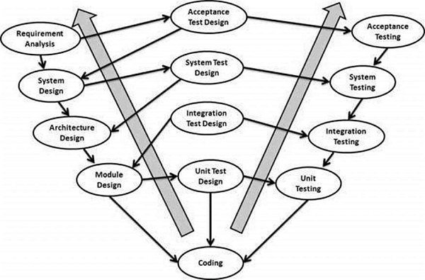
V-Model
Business Requirement Analysis
System Design
Architectural Design
HLD
Module Design
LLD
Coding Phase
Validation Phases
Unit Testing
Integration Testing
System Testing
Acceptance Testing

Slide 17
Where to apply V-Model
Requirements are well defined, clearly documented and fixed.
Product definition is stable.
Technology is not dynamic and is well understood by the project team.
There are no ambiguous or undefined requirements.
The project is short.

Slide 18
V-Model
Pros
Cons
This is a highly-disciplined model and Phases are completed one at a time.
Works well for smaller projects where requirements are very well understood.
Simple and easy to understand and use.
Easy to manage due to the rigidity of the model. Each phase has specific deliverables and a review process.
High risk and uncertainty.
Not a good model for complex and object-oriented projects.
Poor model for long and ongoing projects.
Not suitable for the projects where requirements are at a moderate to high risk of changing.
Once an application is in the testing stage, it is difficult to go back and change a functionality.
No working software is produced until late during the life cycle.

Slide 19
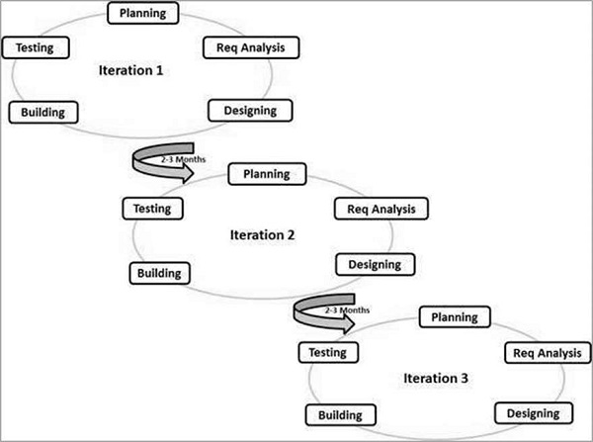
Agile Model
Each Iteration involves:
Planning
Requirements Analysis
Design
Coding
Unit Testing and
Acceptance Testing.

Slide 20
Agile Methodologies
Rational Unified Process (1994)
Scrum (1995)
Crystal Clear, Extreme Programming (1996)
Adaptive Software Development
Feature Driven Development
Dynamic Systems Development Method (DSDM) (1995)

Slide 21
Agile Manifesto
Individuals and interactions − In Agile development, self-organization and motivation are important, as are interactions like co-location and pair programming.
Working software − Demo working software is considered the best means of communication with the customers to understand their requirements, instead of just depending on documentation.
Customer collaboration − As the requirements cannot be gathered completely in the beginning of the project due to various factors, continuous customer interaction is very important to get proper product requirements.
Responding to change − Agile Development is focused on quick responses to change and continuous development.

Slide 22
Agile vs SDLC
Agile is based on the adaptive software development methods, whereas the traditional SDLC models like the waterfall model is based on a predictive approach.
Predictive methods entirely depend on the requirement analysis and planning done in the beginning.
Agile uses an adaptive approach where there is no detailed planning and there is clarity on future tasks only in respect of what features need to be developed. There is feature driven development and the team adapts to the changing product requirements dynamically.

Slide 23
Agile Methodology
Pros
Cons
Is a very realistic approach to software development.
Promotes teamwork and cross training.
Functionality can be developed rapidly and demonstrated.
Resource requirements are minimum.
Suitable for fixed or changing requirements
Delivers early partial working solutions.
Good model for environments that change steadily.
Minimal rules, documentation easily employed.
Enables concurrent development and delivery within an overall planned context.
Little or no planning required.
Easy to manage.
Gives flexibility to developers.
Not suitable for handling complex dependencies.
More risk of sustainability, maintainability and extensibility.
An overall plan, an agile leader and agile PM practice is a must without which it will not work.
Strict delivery management dictates the scope, functionality to be delivered, and adjustments to meet the deadlines.
Depends heavily on customer interaction, so if customer is not clear, team can be driven in the wrong direction.
There is a very high individual dependency, since there is minimum documentation generated.
Transfer of technology to new team members may be quite challenging due to lack of documentation.

Slide 24
TASK FOR THE DAY
FORM A FOUR MEMBER TEAM
CHOOSE A TEAM NAME
CHOOSE A TEAM LEADER FOR THE WEEK
COLLECT E-MAIL IDS OF CANDIDATES

Slide 25
HAVE A NICE DAY

